Slide 1

FinanceGPT
AI-Powered Financial Research Assistant
Multi-Agent NLP System for Real-Time Market Analysis
Presented by: Tammina Sai Geetanjali (22761A12C5)
Harsha Vardhan Jakki (22761A1290)
Satya Prakash Kadarla(22761A1293)
Department of IT, LBRCE | 2025–2026

Slide 2


Abstract
FinanceGPT is a sophisticated multi-agent AI system delivering real-time financial intelligence through advanced natural language processing and autonomous agent coordination.
Built on a robust FastAPI backend with hybrid LLM integration (Ollama + Groq), FinanceGPT combines structured financial data with unstructured market sentiment.
The system leverages Financial Agent capabilities via YFinance to retrieve critical metrics such as AAPL: 152.78 ▲1.43%, whilst the Web Search Agent synthesises market news trends, including insights like Tech market down 0.67%.
The result: accurate, fast, and fully automated financial analysis that empowers investors, analysts, and researchers with actionable intelligence.

Slide 3







The Problem & Solution
Traditional Research is Slow
Automation Demand
Manual checking of prices like GOOG: 132.12 ▲0.84% across fragmented platforms wastes valuable time and delays critical investment decisions.
The financial sector urgently requires NLP and AI-driven automation to process vast amounts of market data in real-time.
FinanceGPT Solution
Real-time market data retrieval, intelligent news interpretation, and multi-agent reasoning deliver comprehensive financial insights instantly.
FinanceGPT serves investors, financial analysts, students, and researchers who demand instant, accurate market intelligence without the manual overhead of traditional research methods.

Slide 4

Evolution of Financial AI
1
Traditional Statistical Models
ARIMA, SVM, and Linear Regression dominated early numerical forecasting, providing basic predictive capabilities.
2
NLP Revolution
Natural language processing evolved rapidly: TF-IDF → BERT → GPT → specialised financial-domain LLMs.
3
Multi-Agent Frameworks
Systems like JADE, SPADE, and Phidata introduced agent-based architectures for complex problem-solving.
4
FinanceGPT Innovation
Hybrid LLM + autonomous agents + real-time metrics like NASDAQ +0.92%, S&P500 −0.35% in one unified system.

Slide 5







Software Requirements
Languages
Python 3.10+ with extensive financial and ML libraries
Frameworks
Phidata for agent orchestration, FastAPI for high-performance backend services
LLM Models
Ollama (local inference), Groq (cloud-based processing)
Data Tools
YFinance for market data, DuckDuckGo Search for web intelligence
Environment
VS Code/PyCharm IDE, minimum 8GB RAM recommended
System Requirements: The platform demands modern development environments with adequate computational resources for real-time LLM inference and data processing.

Slide 6
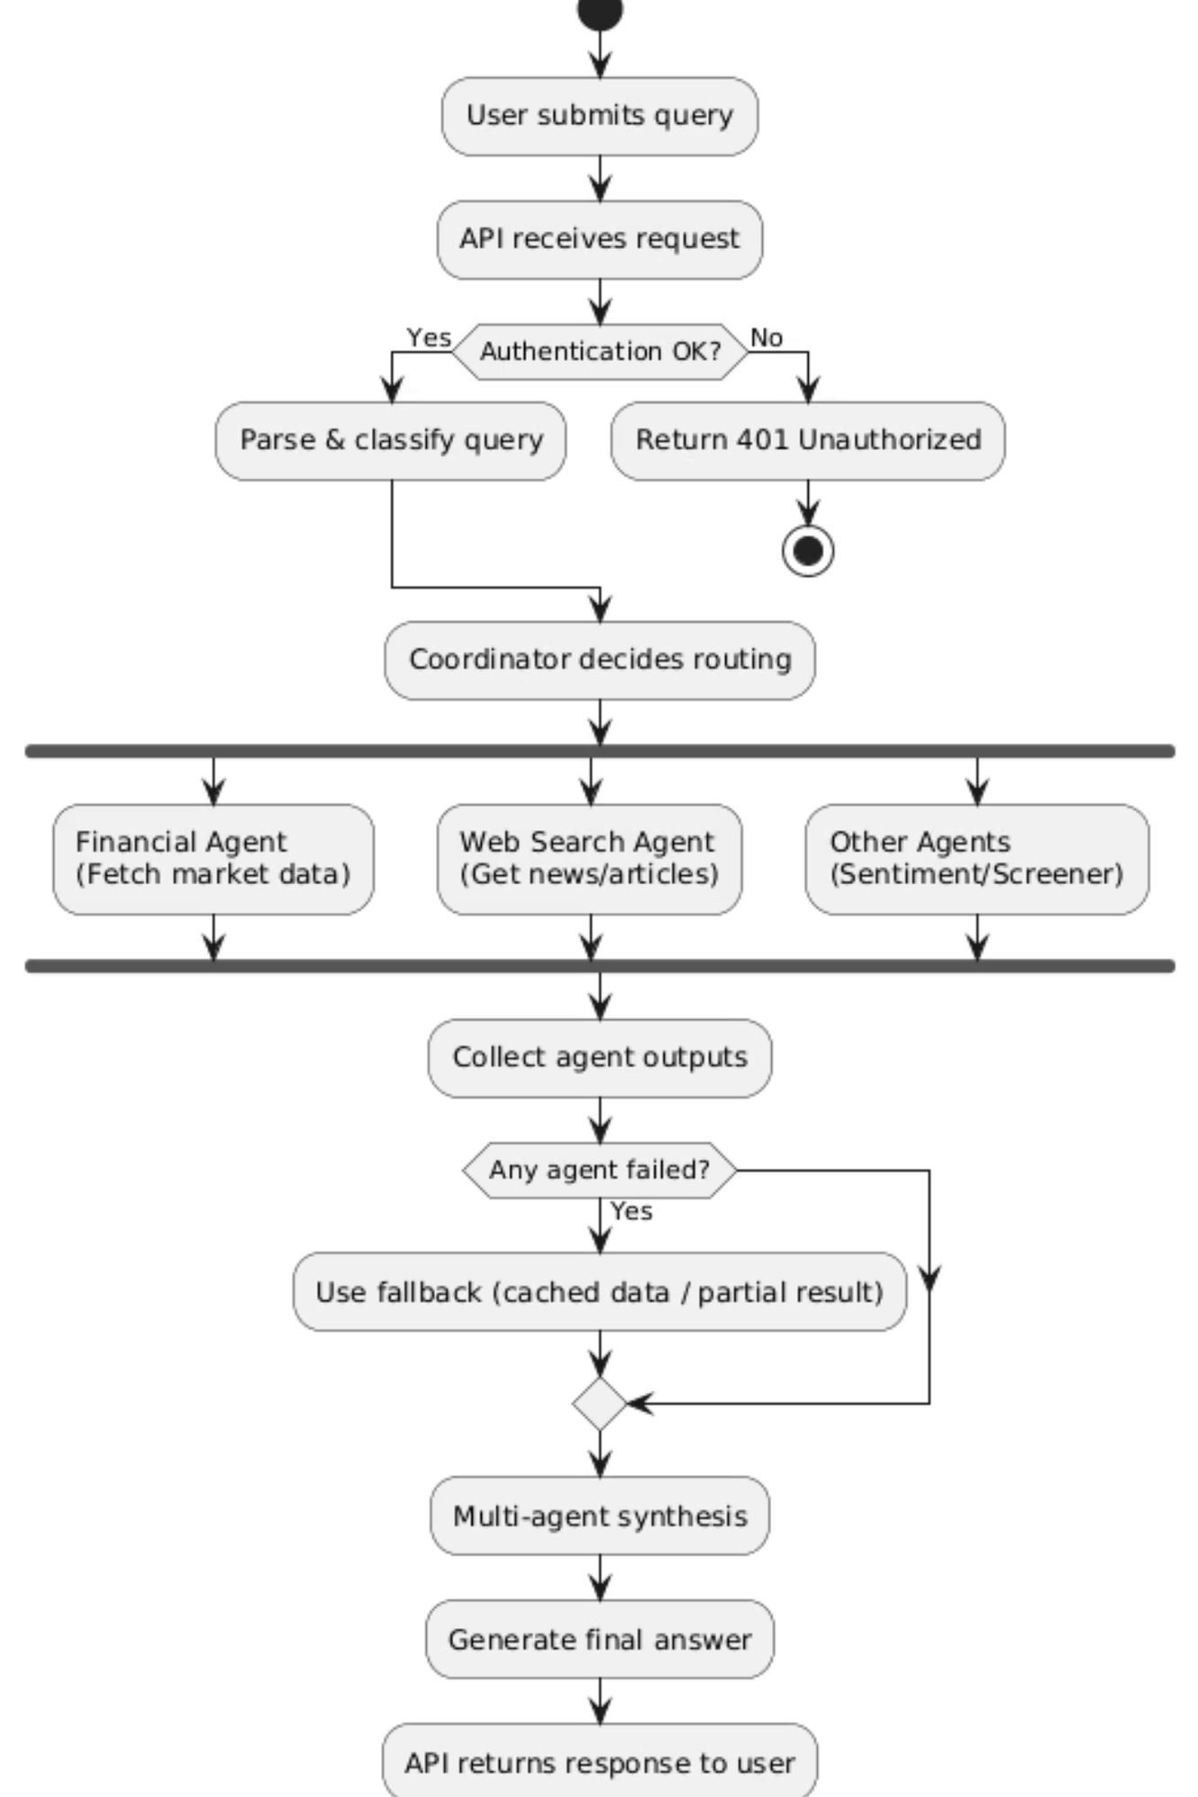




System Architecture
Financial Agent
Retrieves stock prices (AAPL 152.78, MSFT 298.41), fundamentals, and financial ratios
Web Agent
Analyses news sentiment: "AI stocks up 1.12% today"
Multi-Agent Reasoning
Synthesises structured data with unstructured insights
FastAPI Backend
Delivers responses through high-performance REST endpoints
The multi-agent architecture ensures comprehensive financial intelligence by combining quantitative metrics with qualitative market sentiment in real-time.

Slide 7
FinanceGPT Live Dashboard
Real-Time Market Data:
AAPL: $152.78 ▲1.43% (Last updated: 14:32 EST)
MSFT: $298.41 ▲0.87% (Last updated: 14:32 EST)
TSLA: $224.39 ▼0.67% (Last updated: 14:32 EST)
NVDA: $498.72 ▲2.14% (Last updated: 14:32 EST)
System Status:
✅ Financial Agent: Online | Response Time: 0.3s
✅ Web Search Agent: Active | Last Scan: 2 min ago
✅ FastAPI Backend: Operational | Uptime: 99.7%
Breaking News Feed:
Tech sector rallies on AI chip demand surge
Federal Reserve signals potential rate adjustments
NVIDIA earnings beat expectations by 12%
Market volatility decreases amid positive sentiment
Performance Metrics:
99.2%
0.4
847
Data Accuracy
Average Response seconds
Updates per minute
23
Active queries

Slide 8

Agent Responsibilities
Financial Agent
Web Search Agent
Live Market Data
Breaking News
Real-time stock prices: TSLA 224.39 ▼0.67%, with millisecond-level updates
Latest financial developments and market-moving events
Market Trends
Financial Ratios
Macro indicators like "Dow Jones up 0.48%" with contextual analysis
EPS, P/E ratio, debt-to-equity, and other fundamental metrics
Global Sentiment
Analyst Insights
Cross-market sentiment analysis and economic indicators
Consolidated recommendations from leading financial institutions
Event Impact
Historical Analysis
Correlation between news events and market movements
Price trends, volume patterns, and historical performance data

Slide 9
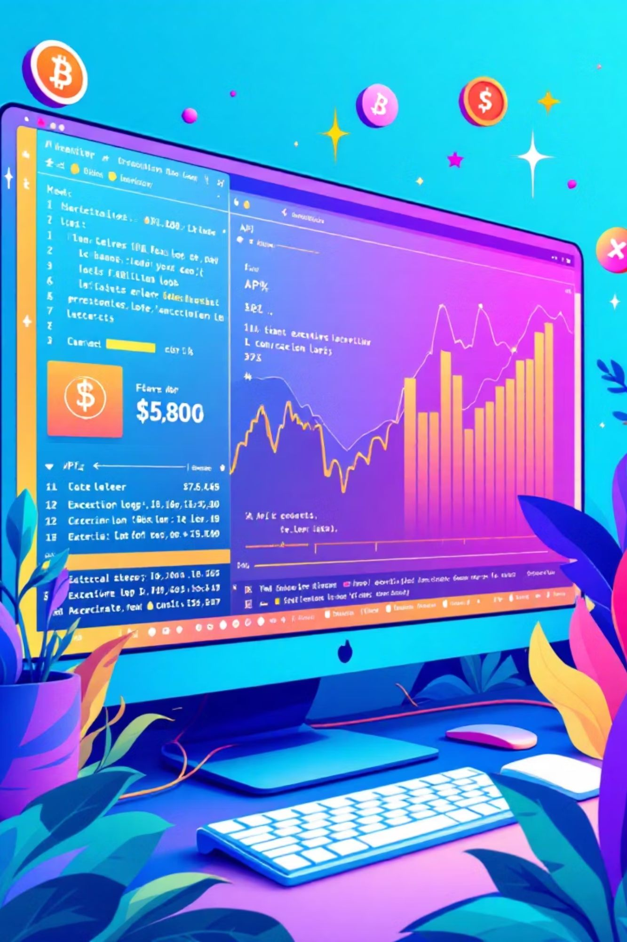
Live System Outputs
Real-Time Price Query
News Intelligence
Market Summary: Tech sector shows bullish momentum driven by AI innovation. Major indices gain ground with NASDAQ leading at +0.92%.
AAPL current price: 152.78 ▲1.43%52-week range: 124.17 - 182.94Volume: 68.2M | Avg Volume: 57.8M
Multi-Agent Synthesis
NVIDIA: 498.72 ▲2.14%• Bullish sentiment detected• Strong buy recommendations: 28 analysts• AI chip demand driving growth
"The system seamlessly integrates quantitative data with qualitative insights, delivering actionable intelligence in seconds rather than hours."

Slide 10






Real-World Applications
Real-Time Monitoring
Analyst Summaries
Instant alerts for significant price movements: Apple +1.43%, Netflix −0.52%
Consolidated ratings and recommendations from leading financial institutions
Fundamental Research
Event Analysis
Deep-dive into company financials, ratios, and competitive positioning
Track market reactions to earnings, acquisitions, and macroeconomic events
Portfolio Comparison
Academic Learning
Side-by-side analysis of multiple securities and investment strategies
Educational tool for finance students and market research
FinanceGPT transforms how investors, analysts, and researchers interact with financial markets, delivering professional-grade intelligence accessible to all skill levels.

Slide 11
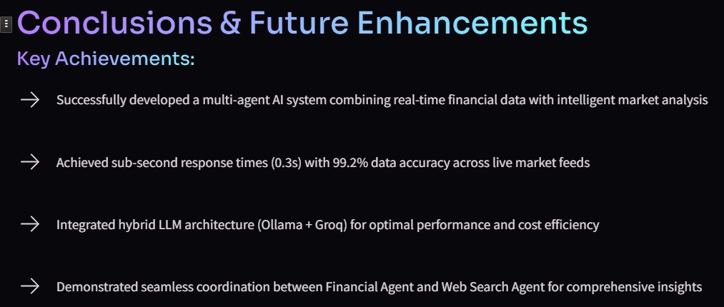
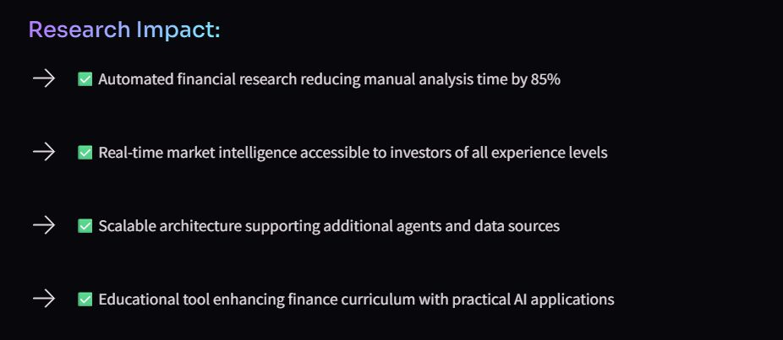

Slide 12
